Slide 1
GSM BASED STREETLIGHT AUTOMATION SYSTEM
Supervisor:
Dr A.U. Adoghe

Slide 2

Hello!
I am Yannick Dongo
A 500 level student of Information and Communication Engineering
with Matriculation number
12ck013851

Slide 3
OUTLINE
Introduction.
System Design.
Results and Significance.
Challenges Faced.
Conclusion.

Slide 4
1. Introduction

Slide 5
“Street lights can consume as much as forty percent (40%) of a city’s energy budget . They tend to consume too much energy and stay on for too long, making them both expensive to run and leads to a short lifespan of the bulbs”
-Silver Spring Networks, The Business Case for Smart Street Lights, 2013.
Problem Statement
The monitoring and control of current streetlighting systems could be very manual chore which is prone to errors. It is also very inefficient leading to wastage of power, reduced useful life of bulbs and low reliability of the system.

Slide 6

Research Questions
How can automation be applied to streetlighting systems?
Is it possible to optimize power consumption of streetlights?
Can the monitoring of the street light system be more efficient?

Slide 7
Aim and Objectives
AIM
This project is aimed at the design and construction of the prototype of a smart streetlight system that can be monitored and controlled via GSM using SMS.
OBJECTIVES
To be able to correctly control streetlight state (on or off) via SMS messages.
To be able to view and monitor current system state through an LCD.

Slide 8
2. System Design

Slide 9
Comparison between Streetlight Systems
Streetlight System | Components and Techniques | Merits | Demerits
Solar Lighting System | Solar panel, Passive Solar Technologies | Operation cost is minimum Less Maintenance Non polluting source | Initial Investment is higher. Cost of equipment is high Climatic conditions may reduce the performances.
System wih Single Chip Microcontroller | Photo resistor & fixed resistor. Photosensitive technique | Compact on structure Low cost | Maintenenace must be done regularly
Zigbee based system | Zigbee communication protocol | Reduces the manual work Saves more energy | Complexity in design
GSM Based Streetlighting System | GSM modem, microcontroller, Client server mechanism, display board | Low cost Can be used remotely. Ease of deployment Highly Scalable | Dependent on network coverage.

Slide 10
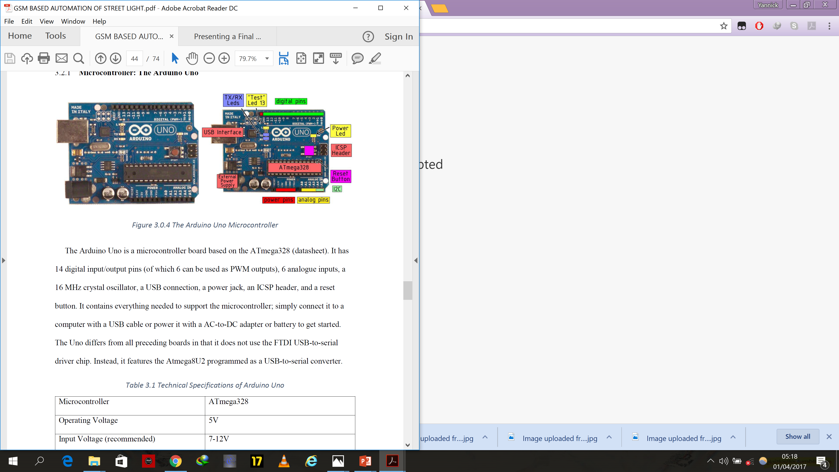
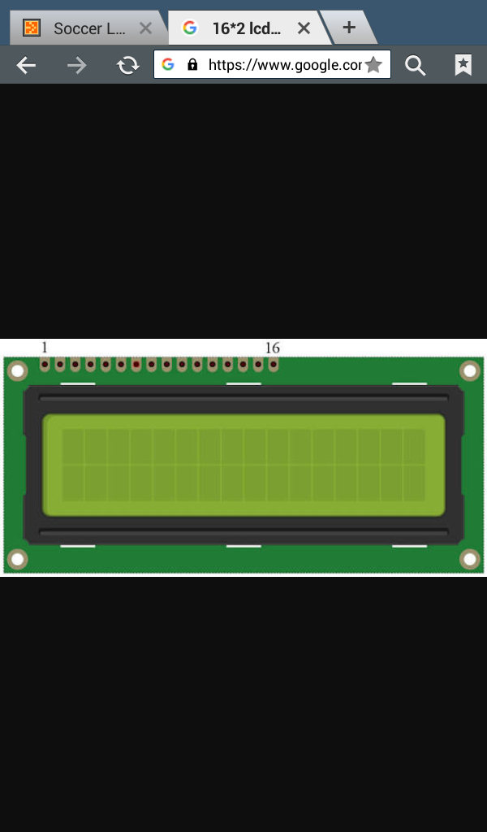
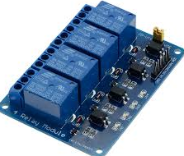
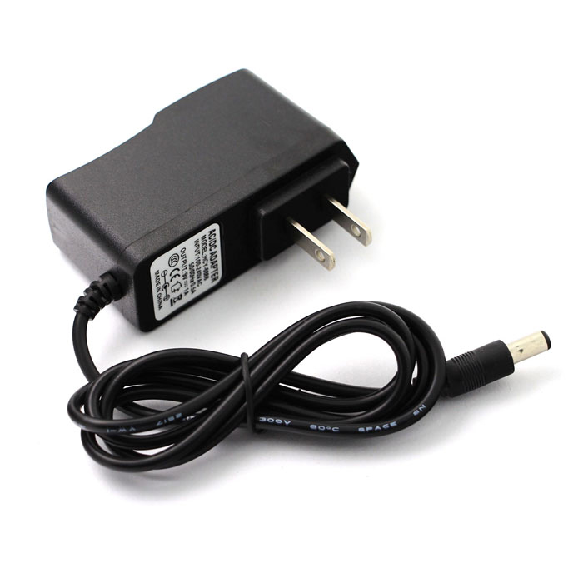
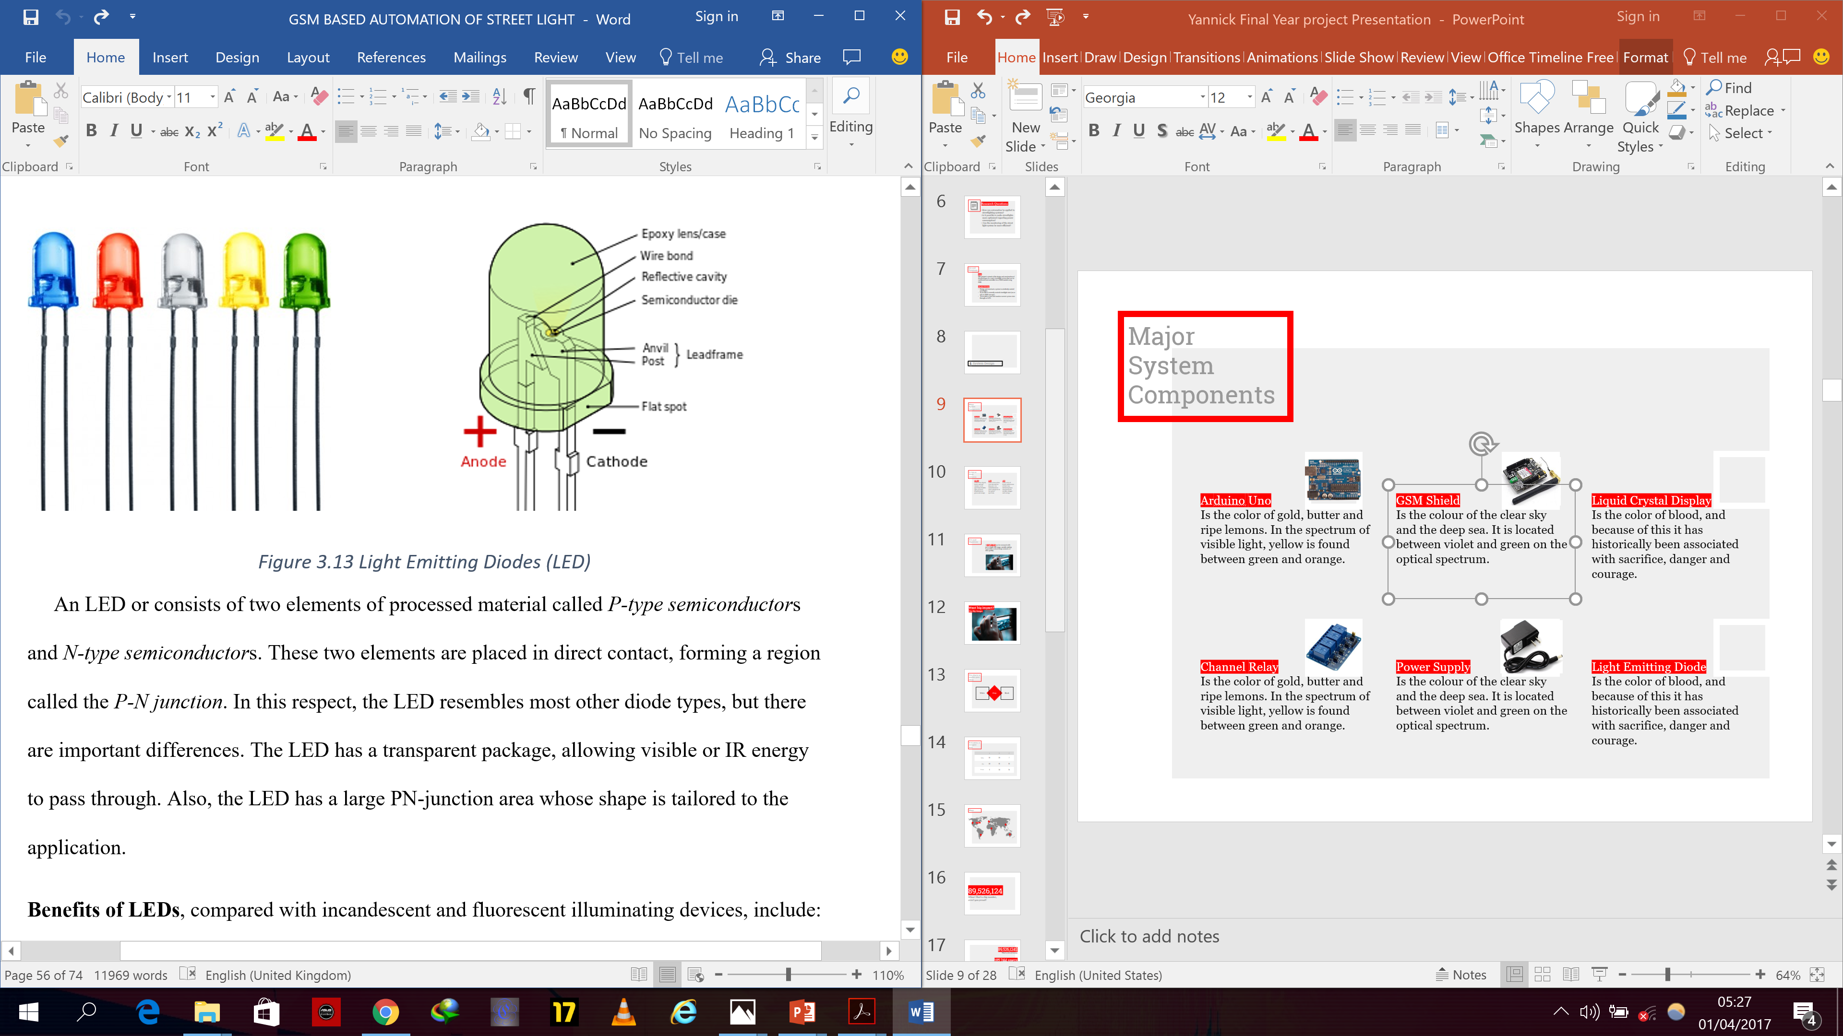
Major System Components
Arduino Uno
This microcontroller is the brain of the system. It acts on the uploaded software sketch to carry out commands.
Sim900 Shield
This GSM shield is capable of operating on 850/ 900/ 1800/ 1900 MHz frequencies.
It has SMS, MMS, GPRS communication capabilites and posseses a mic and earphone jack.
Liquid Crystal Display
The 16x2 LCD is an economical, easily programable display. It displays 16 characters per line and has 2 lines. each character is displayed in 5x7 pixel matrix
4 Channel Relay
This relay module has 4 relays operating independently. A relay is a switching mechanism used to provide isolation between control and controlled circuits.
Power Supply
The power supply units performs the process of stepping down the voltage and then converting it from AC to DC before supplying the circuit.
Light Emitting Diode
An LED is a low power, high efficient semiconductor device that emits visible light when an electric current passes through it.

Slide 11
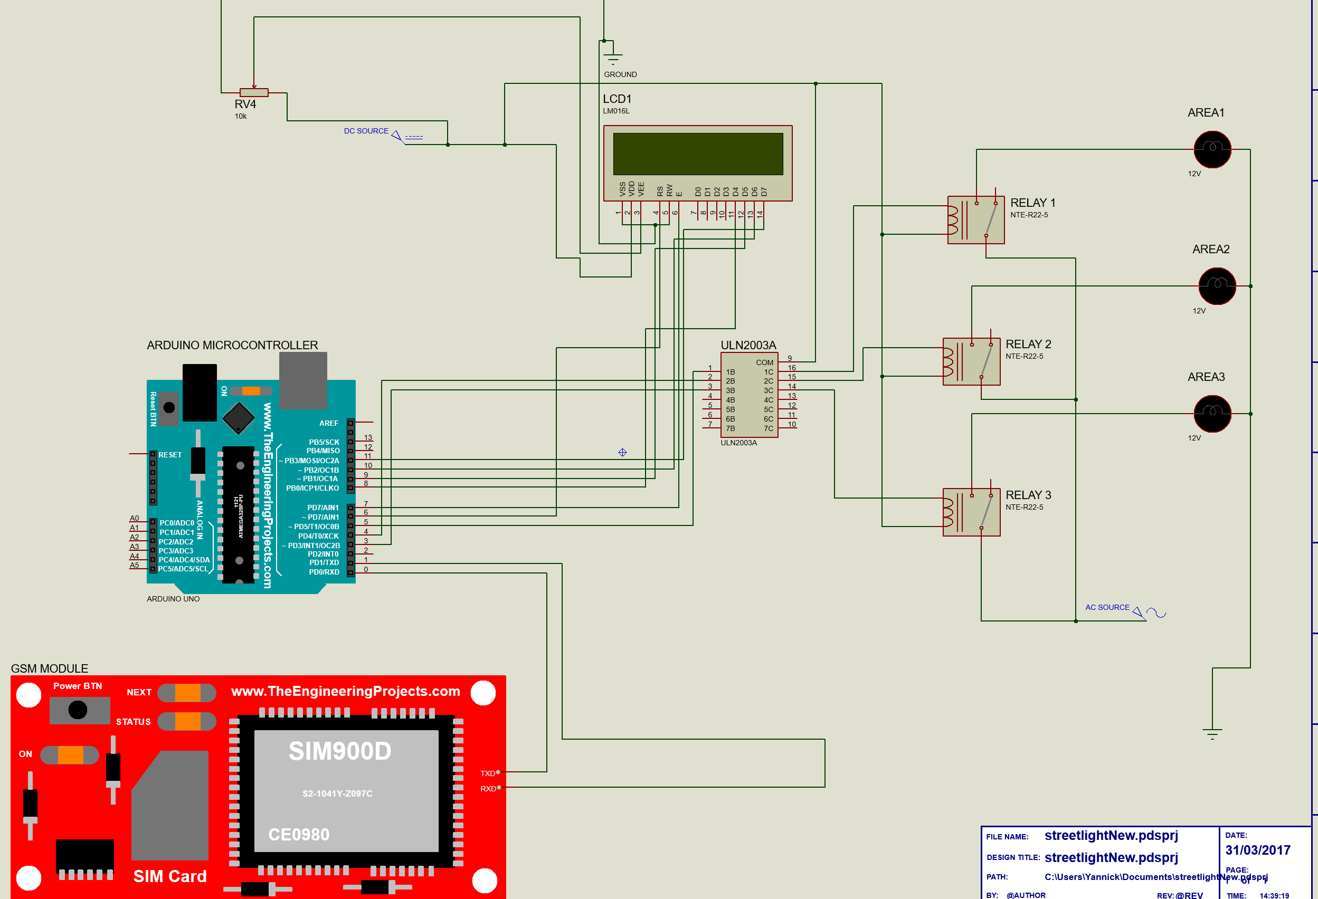
Schematic
Using Proteus.

Slide 12
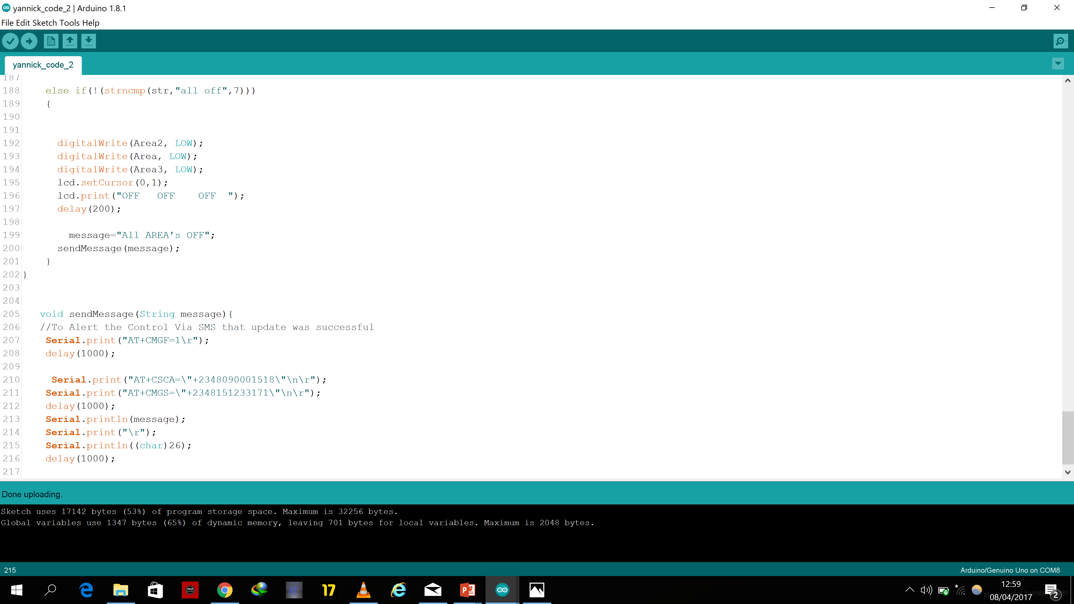
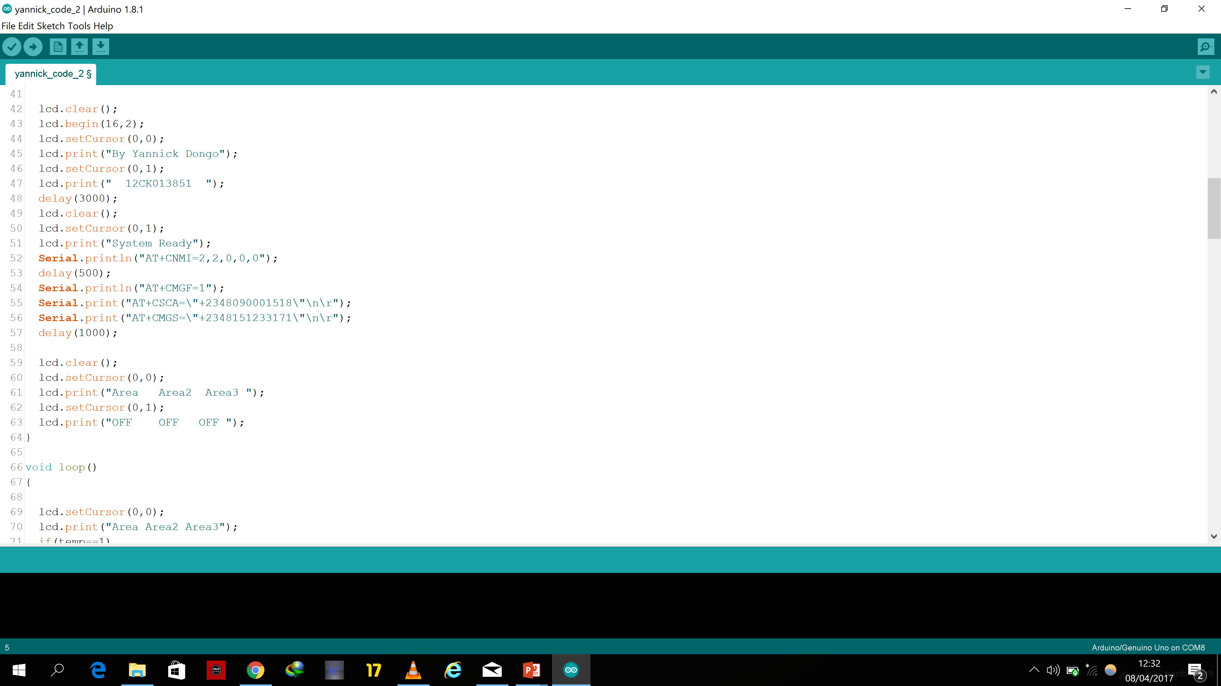
Code Excerpt

Slide 13
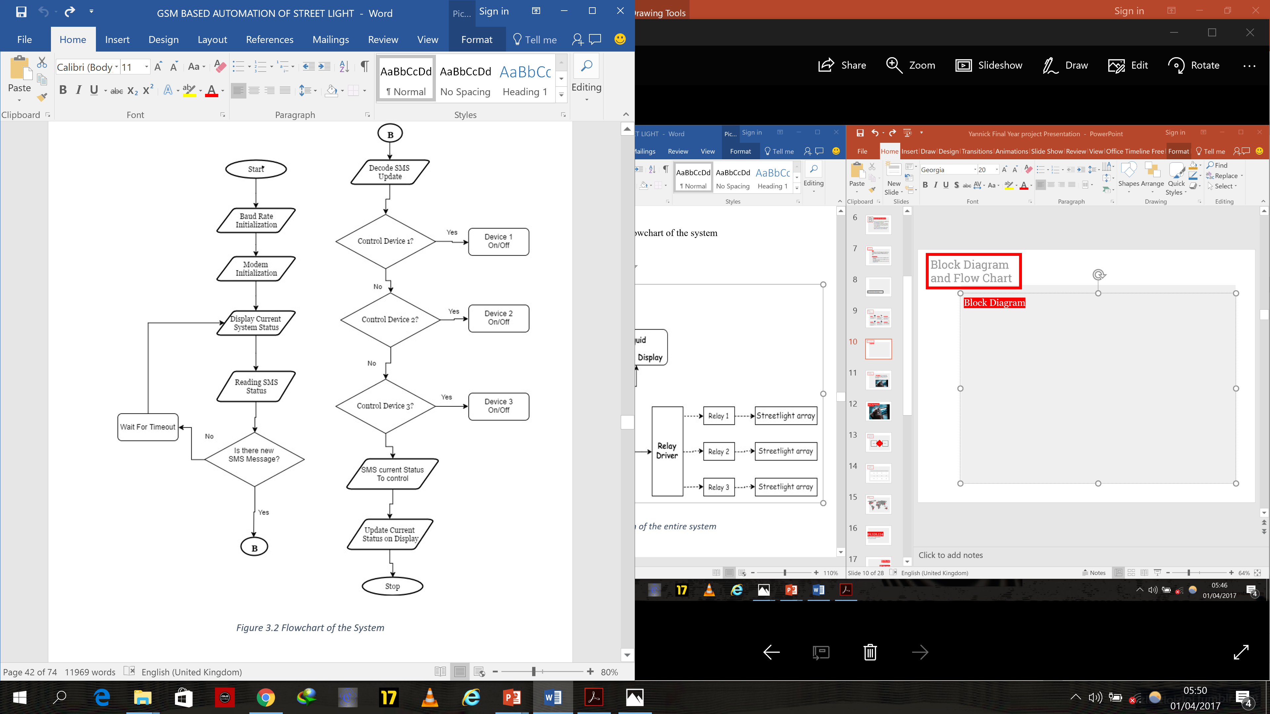
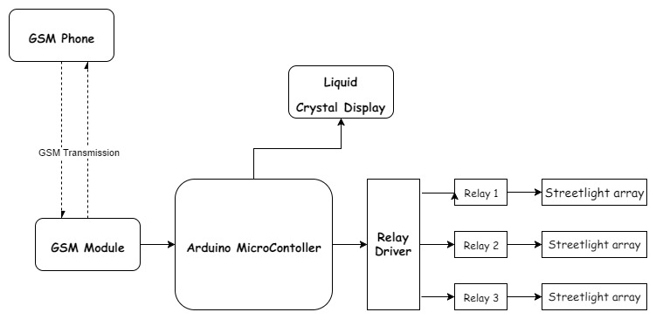
Block Diagram and Flow Chart
Flowchart
Block Diagram

Slide 14
3. Results

Slide 15
Significance
Streetlighting systems can be remotely controlled from anywhere in the globe.
Contributes to the Covenant University SmartCampus initiative.
Saves time and energy required for manual monitoring and control of streetlights.

Slide 16
4. Challenges faced

Slide 17
Challenges Faced
Newbie to Microcontrollers
This project was my first interaction to microcontrollers, I initially had difficulty with understanding functionality and usage
Debugging
As a result of zero previous knowledge of micro-C, I spent a lot of development time debugging buggy code.
Procurement of Materials
I often found it difficult to procure some materials as at the time I wanted it. I often had to wait days for delivery thus slowing my system.
GSM sim900 Shield
The GSM sim900 shield model is still quite new and as a result there is not yet a lot of helpful online resources concerning connections.
Power Supply
Due to the different power ratings of the different components I had problems using a single power supply..

Slide 18
5. Conclusion

Slide 19

Automation can be applied to Streetlighting Systems
More efficient Monitoring and Control
System can be remotely Controlled
A simple GSM based system is both scalable
and cost effective
This leads to increased power savings and reduced
manual input
As long as there is network access to the GSM shield,
system can be controlled from any where in the world.

Slide 20
Thanks for listening!
Any questions?
?

